Slide 1
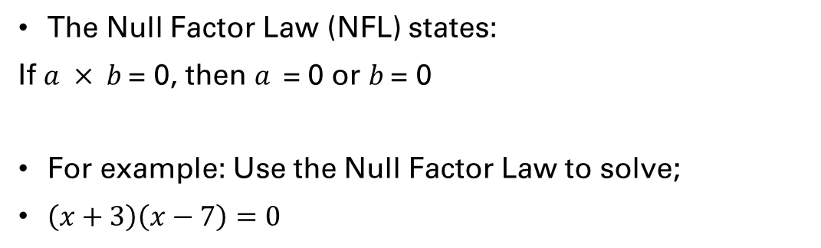
24
7
30
Date
Solving Quadratic Equations?
EQ – How does “= 0” help?
Lets make our equation = 0!
The Null Factor Law (NFL) states:
If $a × b$= 0, then $a$= 0 or $b$= 0
For example: Use the Null Factor Law to solve;
$\left(x+3\right)\left(x−7\right)=0$

Slide 2
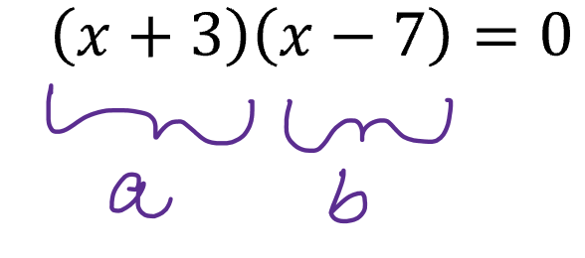
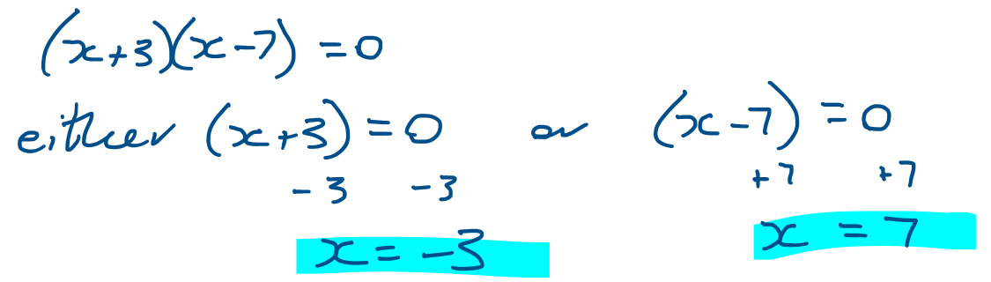

24
7
30
Date
Solving Quadratic Equations?
EQ – How does “= 0” help?
Lets make our equation = 0!
$$\left(x+3\right)\left(x−7\right)=0$$
You need to get both brackets to = 0

Slide 3
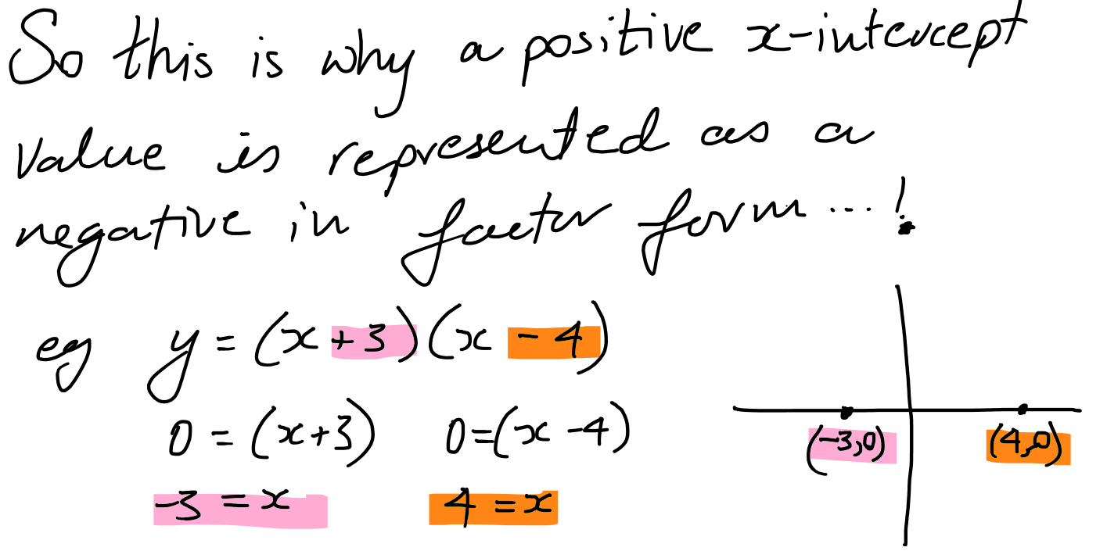
24
7
30
Date
Solving Quadratic Equations?
EQ – How does “= 0” help?
Lets make our equation = 0!
$$\left(x+3\right)\left(x−7\right)=0$$

Slide 4
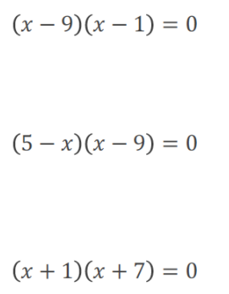
Let’s have a go together

Slide 5
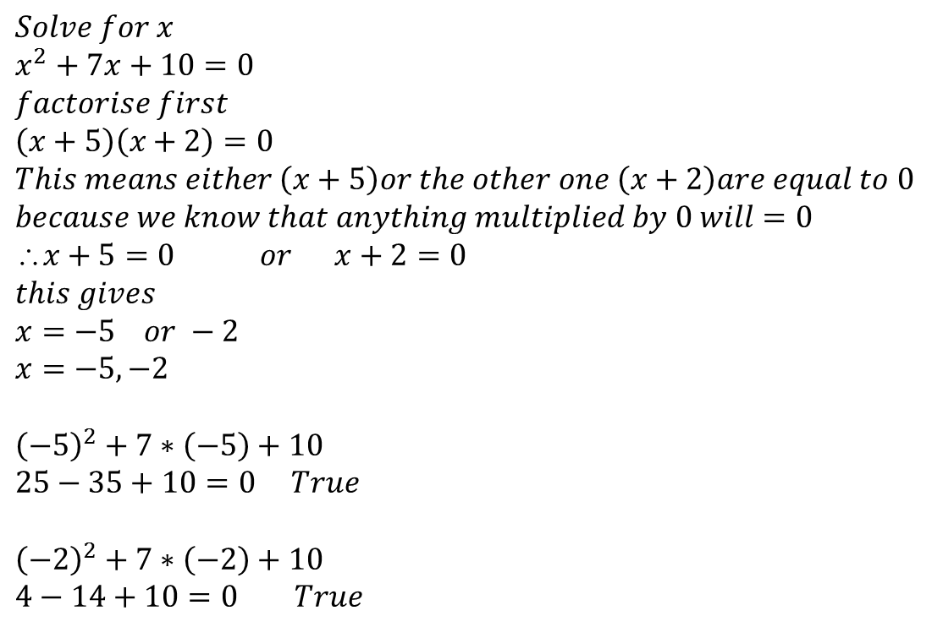
24
7
30
Date
Solving Quadratic Equations?
EQ – How does “= 0” help?
$$Solve for x \\ x^{2}+7x+10=0 \\ factorise first \\ \left(x+5\right)\left(x+2\right)=0 \\ This means either \left(x+5\right)or the other one \left(x+2\right)are equal to 0 \\ because we know that anything multiplied by 0 will=0 \\ x+5=0 or x+2=0 \\ this gives \\ x=−5 or −2 \\ x=−5,−2$$
$${\left(−5\right)}^{2}+7∗\left(−5\right)+10 \\ 25−35+10=0 True$$ $${\left(−2\right)}^{2}+7∗\left(−2\right)+10 \\ 4−14+10=0 True$$
Lets make our equation = 0!
We must have either of these two brackets equalling zero

Slide 6
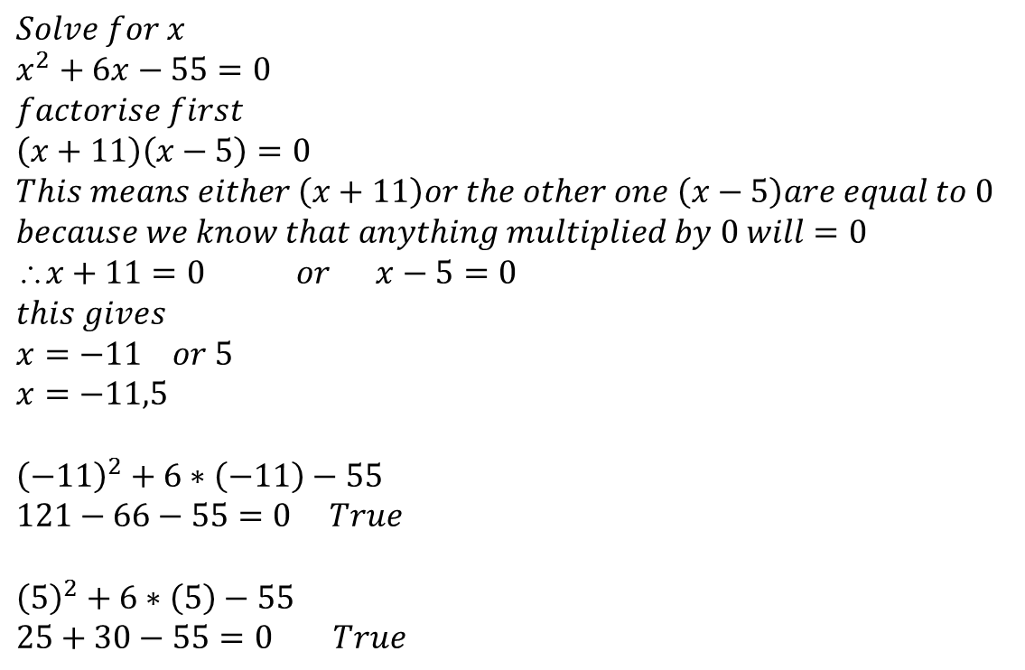
24
7
30
Date
Solving Quadratic Equations?
EQ – How does “= 0” help?
$$Solve for x \\ x^{2}+6x−55=0 \\ factorise first \\ \left(x+11\right)\left(x−5\right)=0 \\ This means either \left(x+11\right)or the other one \left(x−5\right)are equal to 0 \\ because we know that anything multiplied by 0 will=0 \\ x+11=0 or x−5=0 \\ this gives \\ x=−11 or 5 \\ x=−11,5$$
$${\left(−11\right)}^{2}+6∗\left(−11\right)−55 \\ 121−66−55=0 True$$ $${\left(5\right)}^{2}+6∗\left(5\right)−55 \\ 25+30−55=0 True$$
Lets make our equation = 0!

Slide 7
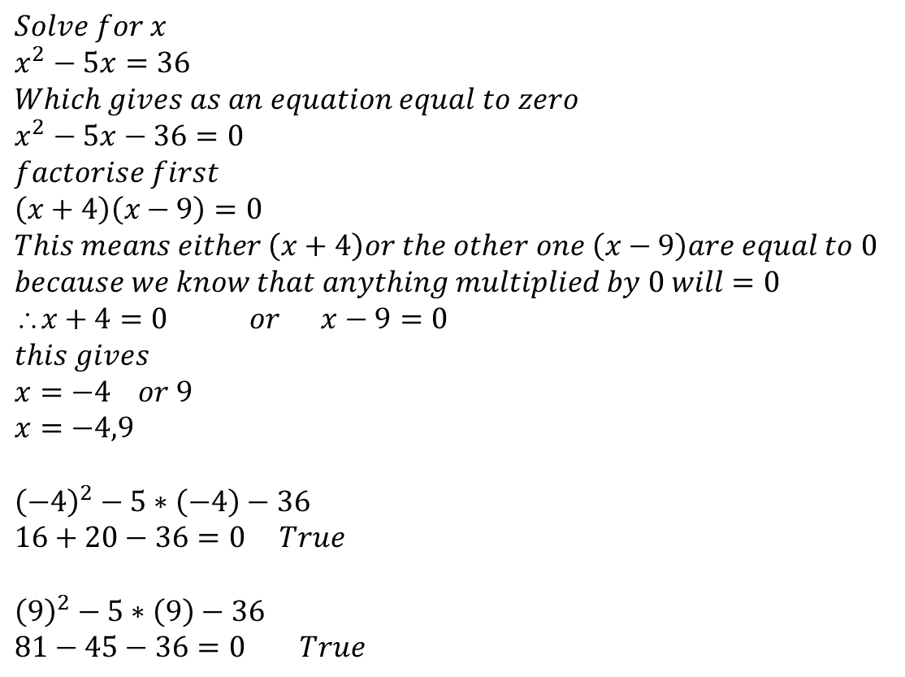
24
7
30
Date
Solving Quadratic Equations?
EQ – How does “= 0” help?
$$Solve for x \\ x^{2}−5x=36 \\ Which gives as an equation equal to zero \\ x^{2}−5x−36=0 \\ factorise first \\ \left(x+4\right)\left(x−9\right)=0 \\ This means either \left(x+4\right)or the other one \left(x−9\right)are equal to 0 \\ because we know that anything multiplied by 0 will=0 \\ x+4=0 or x−9=0 \\ this gives \\ x=−4 or 9 \\ x=−4,9$$
$${\left(−4\right)}^{2}−5∗\left(−4\right)−36 \\ 16+20−36=0 True$$ $${\left(9\right)}^{2}−5∗\left(9\right)−36 \\ 81−45−36=0 True$$
Lets make our equation = 0!

Slide 8
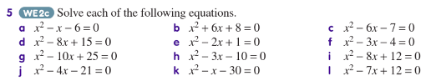

Slide 9
Exercises
Exercise 6.10 from Dwyer
All to be done with a smile on your faces.

